Slide 1

STORMWATER MANAGEMENT AND FLOODING ISSUES
Tuesday, September 3, 2024

Slide 2
STORM WATER GOALS
Reduce the impact of flooding by:
Identifying Choke Points and resolving the Issue
Current Storm Water System is over 100 years old – Average age is 70 years.
Designed to accommodate Drainage for a 15 year storm
Since 2021 there have been 14 -100 year storms
City, County and State must address Climate Change Storm Water Management, erosion, run off and improvement to infrastructure. It’s a collaborative effort

Slide 3
Hurricane IDA - September 1, 2021
Catastrophic and historic levels of damage
City is still recovering 3 years later – Engle Street Retaining wall
Glenwood Road is still closed
Other levels of government are impacting approvals for projects

Slide 4
September 2022
After months of effort the Mayor was able to convince New Jersey DEP and Army Corp of Engineers to meet in Englewood and review IDA Storm aftermath and recover issues
Both DEP and Army Corp of Engineers agreed on desilting, desnagging and the other removal solutions
Work began immediately to desnag and desilt the Overpeck Creek
Approximately 550 truck loads of material has been removed from the Overpeck Creek
East/West Culverts that were silted in for years were opened and are now properly flowing

Slide 5
September 2022
Senator Gordon Johnson contacts Englewood about a potential Storm Water Study by NJIT Rutgers & Stevens Institute.
The City meets with the Study Team in October 2022
Both agree that a grant application should be submitted
Grant is awarded in December of 2023
Grant implanted in March 2024
Approximately 2.5 year study

Slide 6
Since March 2024
Drones have been flown over the waterways
Elevation data is being entered and plotted
35 Structures (culverts and bridges) have been identified along Overpeck Creek and Metzler Brook
Sensors placed in streams
Cameras placed in the Overpeck Creek
More sensors and cameras to be installed
A high resolution Terrain Map is being created
When built out it will be able to receive real time data and provide warning to officials

Slide 7
On March 8th 2024, the City Manager organized the Regional Flooding and Storm Water Mitigation Group with the following:
Bergenfield
County of Bergen
Cresskill
Englewood Cliffs
Englewood
Fort Lee
Leonia
NJIT
Palisades Park
State OEM
Teaneck
Tenafly
Representation from Congressman Gottheimer’s Office
Representation from State Senator Gordon Johnson and Assembly Member Haider & Park

Slide 8
Council Actions to Reduce Flooding and
Address Climate Changes
Purchase of 47 Brook Avenue for Retention Basin
Adopted Storm Water Management Plan in October 2023
Funded required studies and updates for Storm Water Plan
Insured that Storm water flooding and other related issues are reviewed as part of the Master Plan
Purchase of Equipment to clean out catch basins, culverts and waterways
Desnagging of Flat Rock Brook in 2023

Slide 9
CHOKE POINTS
CSX – swales along the tracks have not been maintained for decades
In September of 2023 the City DPW removed a 260 foot long clog that backed up onto South Dean Street
New Jersey Turnpike Authority Drainage Easement behind Knapp Place (August 6th Storm)

Slide 10
August 6, 2024
5.9 inches of rain in approximately 3 hours
Storm cell slated over Englewood Cliffs and Englewood
Over 300 people rescued
Storm occurred at rush hour
7 Fire Departments assisted the Englewood Fire Department

Slide 11
August 18, 2024
2.5 inches of rain in 25 minutes
Peak of Storm around 8:00 p.m.
Storm Key
Red – is over 2 feet of water
Yellow – is up to 2 feet of water
Dark Blue – is up to 1 foot of water
Light Blue – is up to 6 inches of water

Slide 12
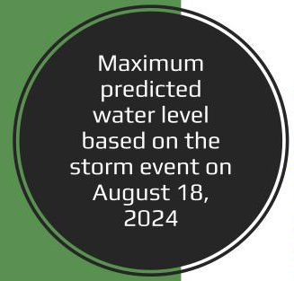
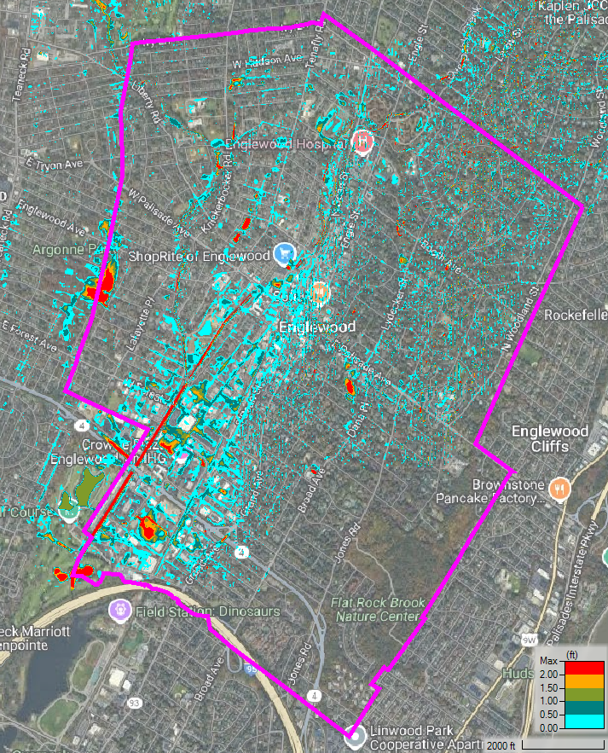


Overall

Slide 13
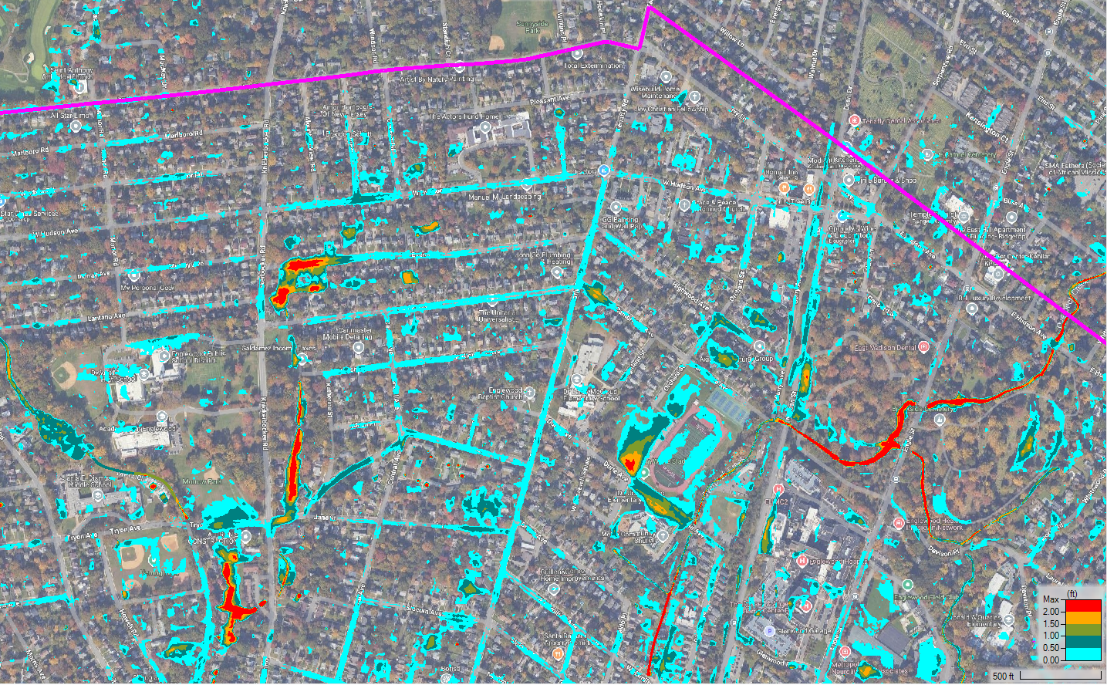
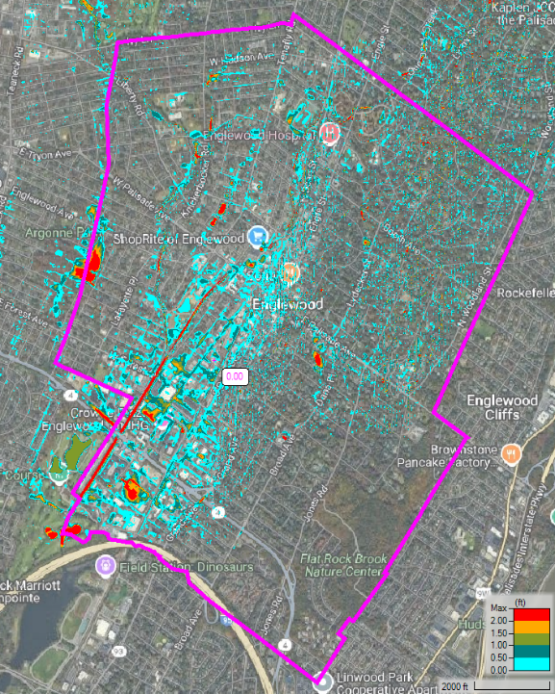
North
Everett Pl.
Dwight Morrow HS
Overpeck Creek
Winton White Stadium
Metzler Brook
Overpeck Creek

Slide 14
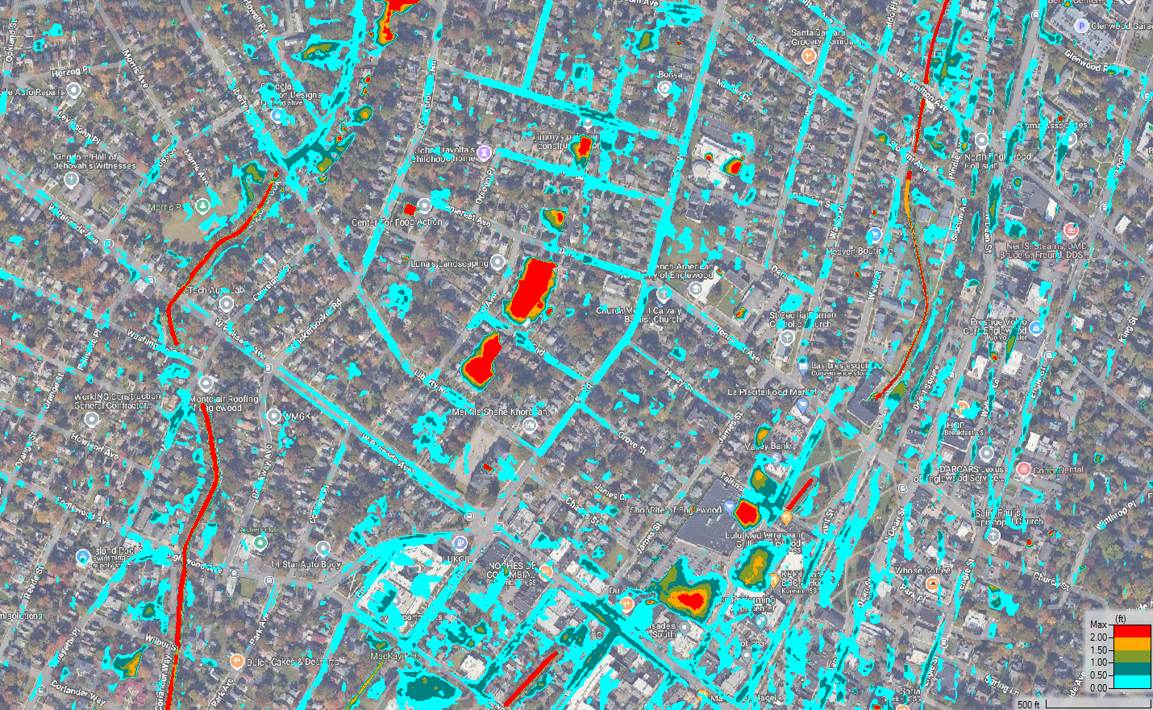
Central
Overpeck Creek
Center for Food Action
Metzler Brook
Central Ave.
Residential Area
Depot Square Park
ShopRite Parking

Slide 15
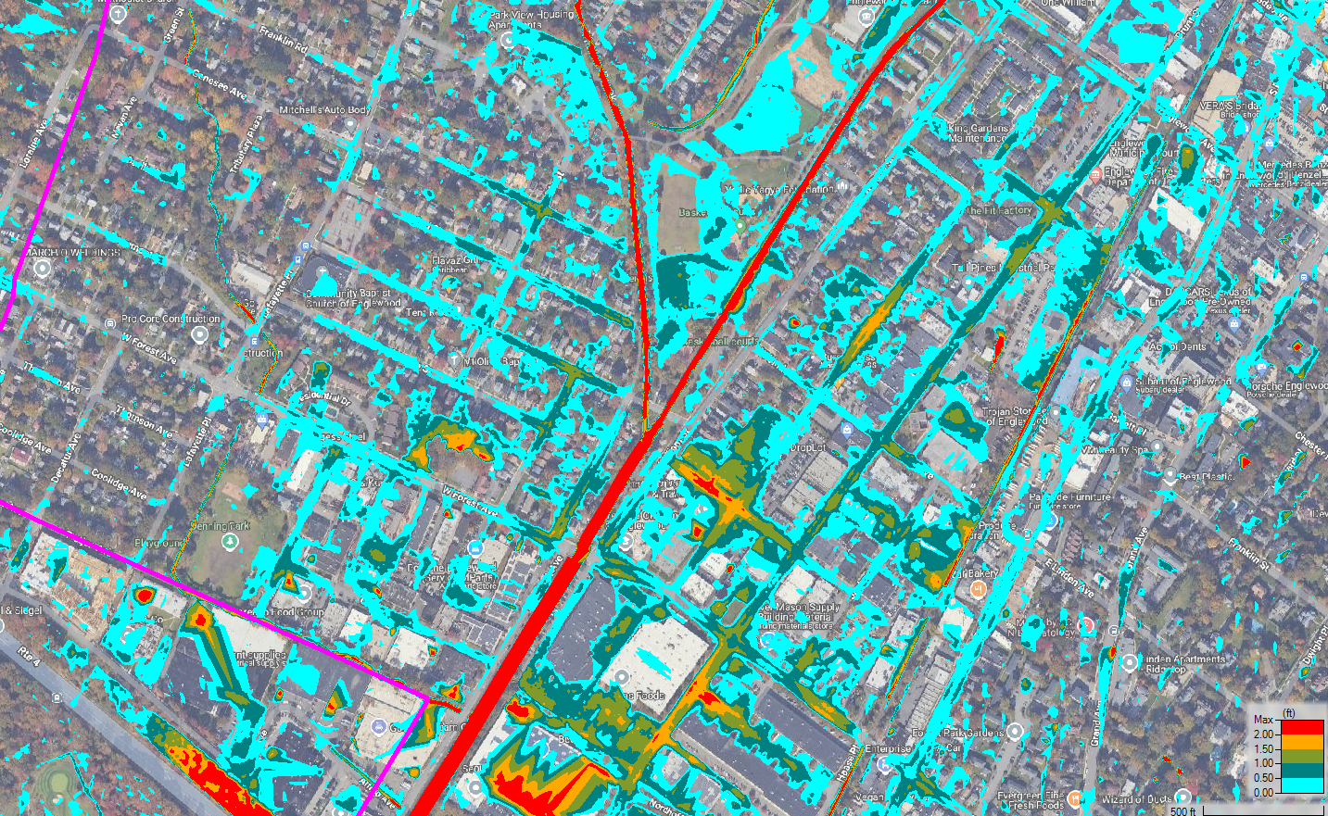
South
Mackay Park
Metzler Brook
Columbus Ave.
Overpeck Creek
Van Brunt/Lewis Intersection

Slide 16
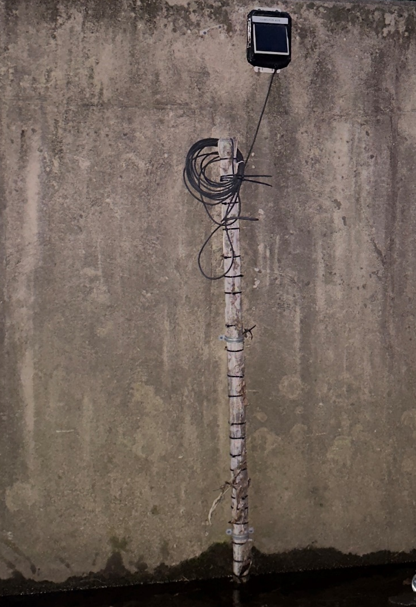
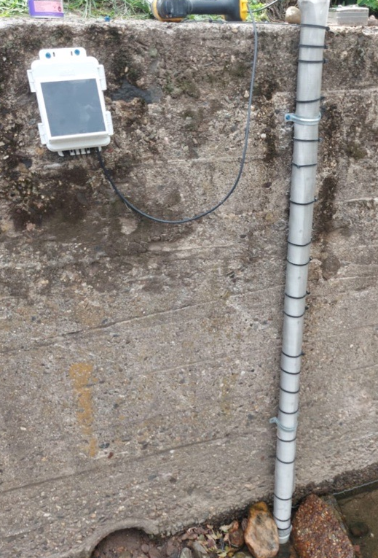
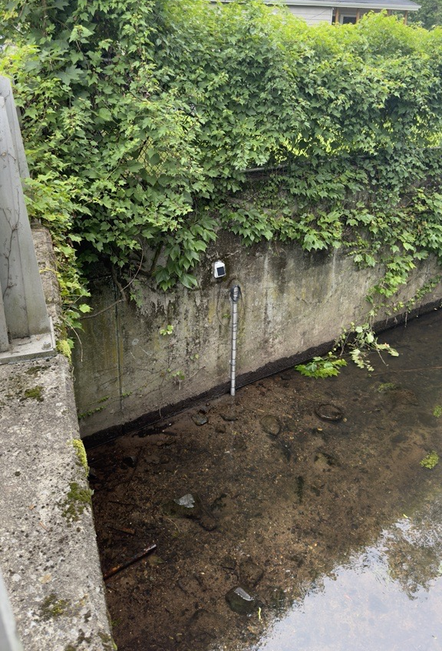
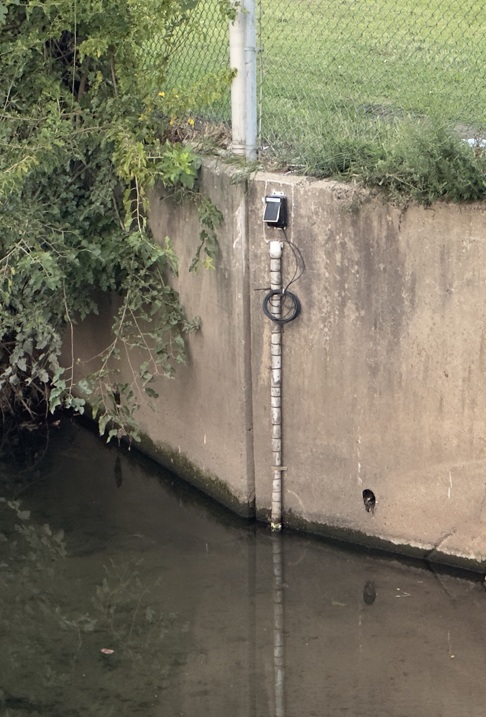
Water level sensors
Hamilton Ave
Depot Sq Park
Wilbur St
Forest Ave
cnr.njit.edu

Slide 17
LONG ARM
Plan going forward
Upgrade Storm Water System in logical sequence
Use data from NJIT Study to design Storm Water Upgrades
Address flooding issues regionally
CSX and Turnpike Authority must maintain easements on a regular basis
Work with the State and Federal government to keep stream banks formalize and in the same location
Be Proactive in designing retention basins
Work with Planning Board and Zoning Board to decrease the amount of imperious coverage allowed on each parcel

Slide 18
